Slide 1
AgroChat – Connecting Farmers, growing knowledge
PIP2001 Capstone Project
Review-3
Batch Number:
Under the Supervision of,
Dr. Mohana B D
Professor / Associate Professor / Assistant Professor
School of Computer Science and Engineering
Presidency University
Roll Number | Student Name
20211CIT0103 20211CIT0129 20211CIT0078 | PRAMODA KUMARA K M KAKUMANU ASHOK REDDY PRATYAKSH YADAV
Name of the Program: Computer Science & Engineering (IoT)
Name of the HoD: Dr. Anandraj
Name of the School Project Coordinators: Dr. Sampath A K / Dr. Abdul Khadar A / Mr. Md Ziaur Rahman

Slide 2
Introduction
We’re building a platform similar to Stack Overflow, but specifically designed for farmers. The idea is to create a space where farmers can ask questions, share knowledge, and provide advice to each other, leveraging the collective experience of the community. The platform will enable farmers to troubleshoot problems, improve crop yields, and adopt better farming practices through peer-to-peer interaction. By crowdsourcing advice and integrating data-driven insights, the platform aims to foster innovation and collaborative learning in the agricultural sector.

Slide 3
Literature Review
1. "Climate Change and Agriculture: Impacts and Adaptation"
2. "Integrated Pest Management: Concepts and Strategies"
3. "Soil Health: A New Paradigm for Sustainable Agriculture"
4. "Precision Agriculture: Technology and Economic Perspectives"
5. “React, Nodejs docs.”
6. “Prisma ORM docs”

Slide 4
Existing method Drawback
No platform that tackles this issue.
Farmers can only ask to limited no of people for advice
If they come across people who aren’t aware of a situation, they might end up giving wrong advice
Advice can only be asked by government agricultural bodies or some agricultural department that they think is good enough

Slide 5
Proposed Method
Build a platform where farmers can ask questions, answer others questions for free.
Allow farmers to add details to make it easier for others to answer, example pictures, place, type of crop, soil, expertise in farming, type of pesticides used etc.
After a question is posted, allow farmers to respond and create a method to rank the most upvoted/liked advice, which means that it’s the advice that most people agree with and rank it at the top, if its wrong, people will see it and start downvoting.

Slide 6
Objectives
Enable users to create a question.
Allow users to add comments/advice on question
Allow users to save and persist data
Add login and logout
Add upvote and downvote
Add logic to rank highest voted answer for each question.

Slide 7
Methodology/Modules
1. Develop a user-friendly interface allowing farmers to easily post questions and share solutions.
2. Implement a tagging system for categorizing queries by crop type, issue, or farming technique.
3. Utilize a peer-ranking mechanism to prioritize high-quality answers and promote expert advice.
4. Integrate real-time data analytics for informed decision-making and trend insights in farming practices.

Slide 8
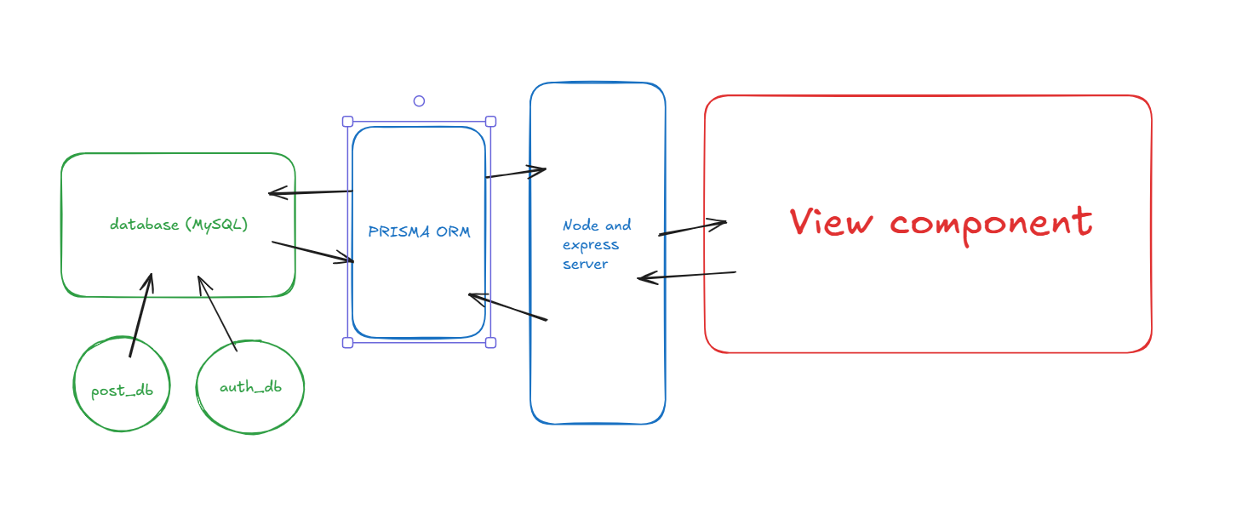
Architecture

Slide 9
Software components
Backend-Node & Express
Frontend-Frontend is rendered from backend
Database
ORM-Prisma

Slide 10
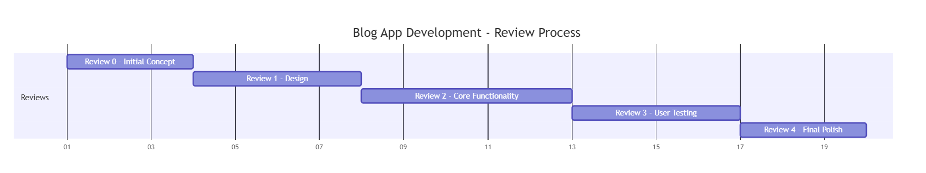
Timeline of Project

Slide 11
Expected Outcomes
Farmers will be able to get advice just by asking a question on the platform
Mistakes that happen due to bad choices will reduce drastically
New farmers who haven’t had a history of farming will learn quickly
The crop production in a particular area will increase

Slide 12
Conclusion
In conclusion, this platform will transform how farmers share knowledge by crowd-sourcing advice and fostering collaboration. By connecting farmers globally, it will help solve agricultural challenges, improve decision-making, and promote more sustainable farming practices.

Slide 13
Github Link
The Github link provided should have public access permission.
Github Link
https://github.com/ashokDevs/capstone.git

Slide 14
References
1. Farmer Knowledge as Formal Knowledge explores farmer-led research and knowledge-sharing networks, offering insights on how peer-to-peer interaction can enhance agricultural practices through participatory approaches.
2. Peer-to-Peer Knowledge Sharing Platform for Farmers discusses platforms that facilitate real-time problem-solving and knowledge exchange among farmers, with a focus on utilizing technology
3. Incentive for Peer-to-Peer Knowledge Sharing Among Farmers looks at factors motivating farmers to engage in knowledge sharing, relevant for structuring engagement on a Q&A platform.

Slide 15

Project work mapping with SDG

Slide 16
Thank You

